Slide 1
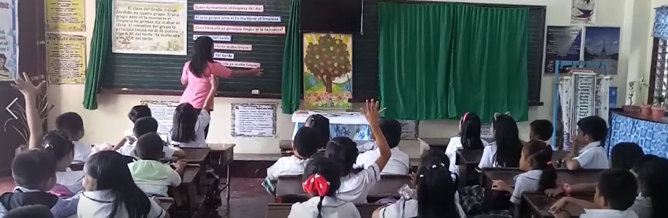
Results and Implications of a 2019 Study of Fidelity of Implementation of the Mother Tongue-Based Multilingual Education (MTB-MLE) Policy in the Philippines
CIES 2021
Karon Harden, RTI International

Slide 2



Background on MTB-MLE Policy in the Philippines
183 languages
Based on positive results from empirical studies in the Philippines and abroad, the Philippines Department of Education (DepEd) Order No. 74 established the Mother Tongue-Based Multi-Lingual Education (MTB-MLE) policy in 2009.
The students’ mother tongue (MT) is the main medium of teaching and learning (MoTL) in KG through Grade 3.
Filipino and English are introduced as additional languages starting in Grade 1, and their usage gradually increases until they take over as the primary MoTL in Grade 4.
In addition, DepEd has also provided guidelines regarding teacher assignments, school MT selection, class sectioning, materials provisioning, and more.

Slide 3
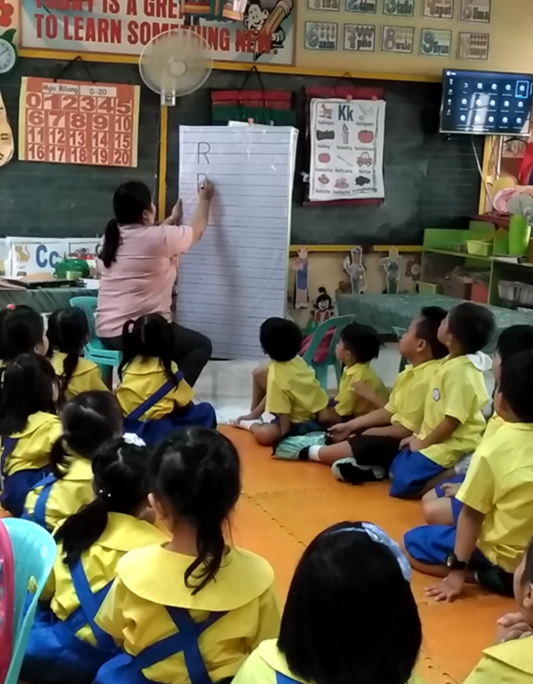
Purpose of the Study
To help DepEd examine how actual classroom practice was conforming to or diverging from the policy across locations with different contextual characteristics
Not an evaluation of the merits or effectiveness of the policy but a measure of fidelity of implementation to it

Slide 4
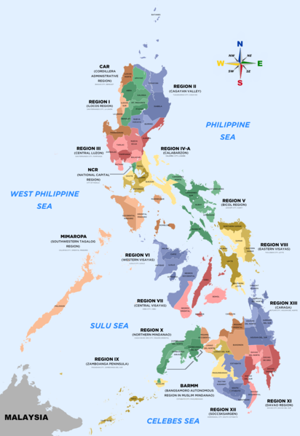

What We Did
Using a representative sample:
in Regions IX, X, XII, and Bangsamoro Autonomous Region in Muslim Mindanao (BARMM)
of 160 schools total with these MTs:
40 Bahasa Sug
40 Chavacano
40 Magindanawn
40 Mëranaw
in 638 classrooms (~1 KG–G3 classroom each per school)
Collected in Feb-March 2019:
3,047 timed lesson observations (~5 per grade per school)
638 teacher language background interviews (~1 per grade per school)
638 classroom inventories of materials & student MTs (~1 per grade per school)
(Simultaneous EGRA in G2, G3)
Map by Sanglahi86, CC-BY 4.0

Slide 5
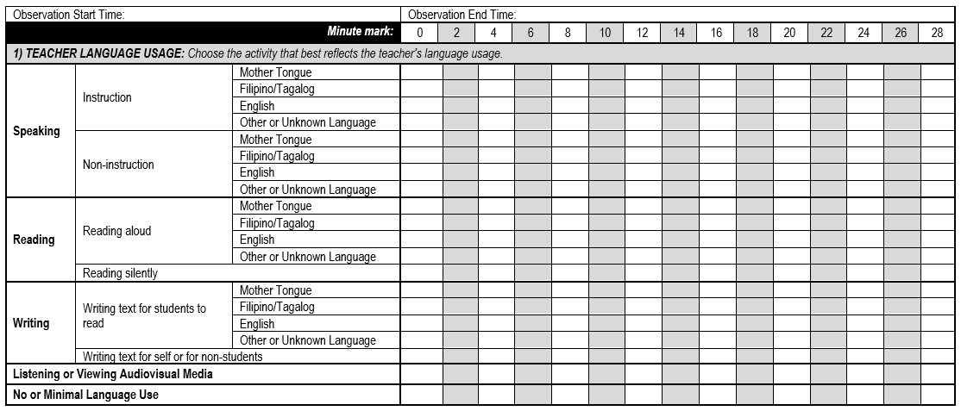
Lesson Observation Instrument: Teacher Language Usage
Also collected data on:
-Teacher use of inter-linguistic “bridging” strategies (e.g., explicit vocabulary instruction, visual aides, translation or code-switching, etc.)
-Student MT survey and language usage (timed, similar to above, but for students)
-Availability and use of materials, and in which languages
-Teacher language background and attitudes (interview)

Slide 6
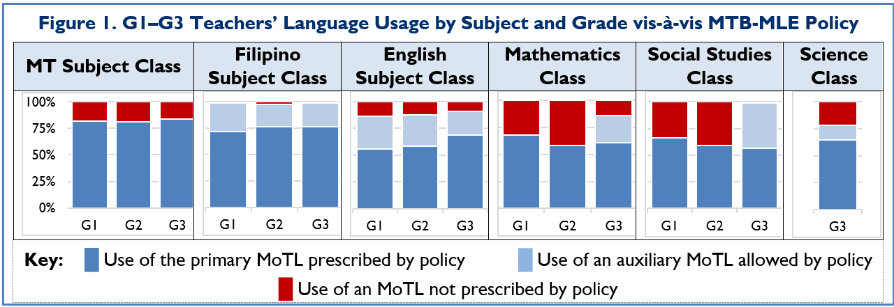
Findings: MoTL Usage
Policy:
In Practice:
Table 1. Prescribed Primary and Auxiliary MoTL by Grade and Subject
Subject | KG | G1 | G2 | G3
MT | MT only | MT only
Filipino (L2) |  | Primarily Filipino but some MT allowed
English (L3) |  | Primarily English but some MT allowed
Math |  | MT only |  | Primarily MT but some English allowed
Social Studies |  | MT only |  | Primarily MT but some Filipino allowed
Science |  | - |  | Primarily MT but some English allowed

Slide 7
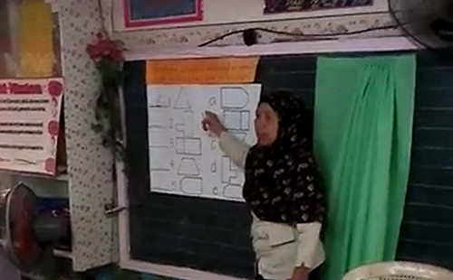
Findings: Teacher MT-School MT Match
Policy: Hire teachers proficient in the school MT
In Practice: Teacher MTs
Bahasa Sug MT School Teachers | Chavacano MT School Teachers | Magindanawn MT School Teachers | Mëranaw MT School Teachers
Notes:
The policy encourages schools to hire teachers who are proficient in the given MT.
In the teacher interviews, we asked the teachers to self-report their speaking ability in the school MT.
We found some variation by MT group, but across all groups, a majority of teachers were comfortable at least in using the MT for informal conversation.

Slide 8
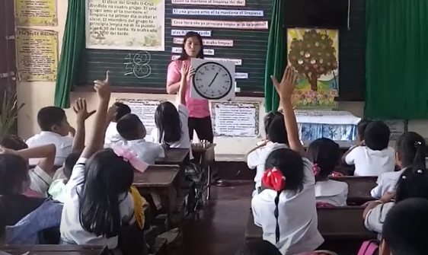
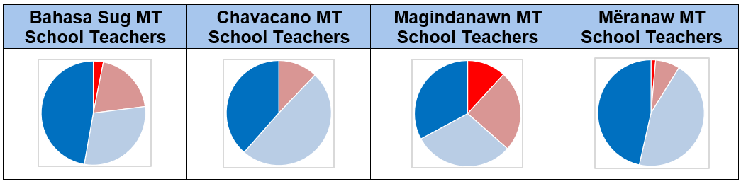
Findings: Teacher Proficiency in the MT
Policy: Hire teachers proficient in the school MT
In Practice
Overall:
Key:
Variations by MT Group:
█ At ease using the school MT both for informal conversations and for teaching
█ At ease using it for informal conversations, but sometimes have challenges using it for teaching
█ Speak it with some effort
█ Do not speak it

Slide 9
Associations between Teacher Proficiency in the MT and Teacher MT Usage in Class
Teacher MT/School MT Match:

Slide 10
Associations between Teacher Proficiency in the MT and Teacher MT Usage in Class
Teacher Comfort Level in Speaking the MT:

Slide 11
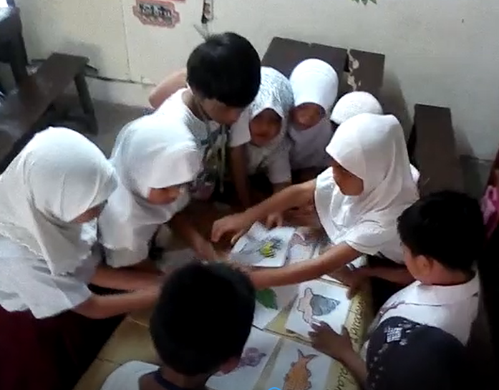
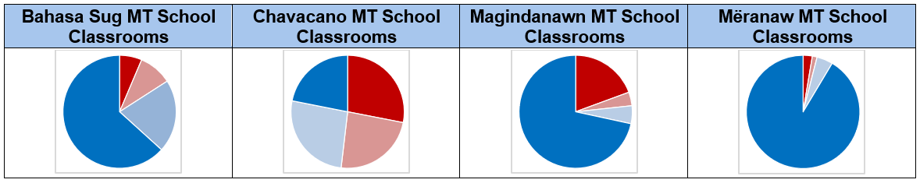
Findings: Linguistic Homogeneity
Policy: Use language mapping and class sectioning to optimize linguistic homogeneity
In Practice, by MT Group:
Key:
█ High Homogeneity (>95% of students with home-school MT match)
█ Moderate Homogeneity (75-94% -“-)
█ Moderate Heterogeneity (50-74% -“-)
█ High Heterogeneity (<50% -“-)

Slide 12
Associations between Linguistic Homogeneity of the Student Population and Teacher MT Usage in Class

Slide 13
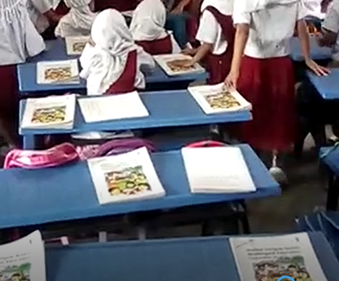
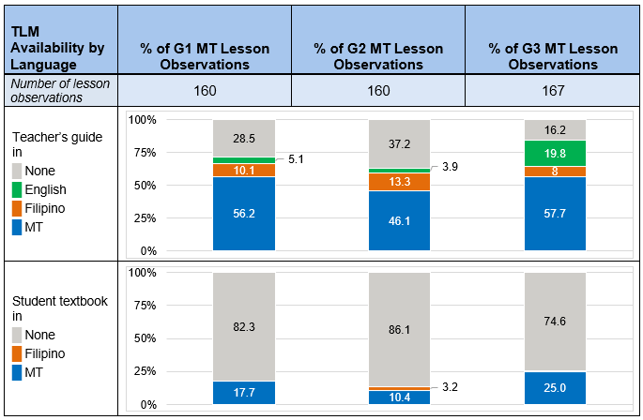
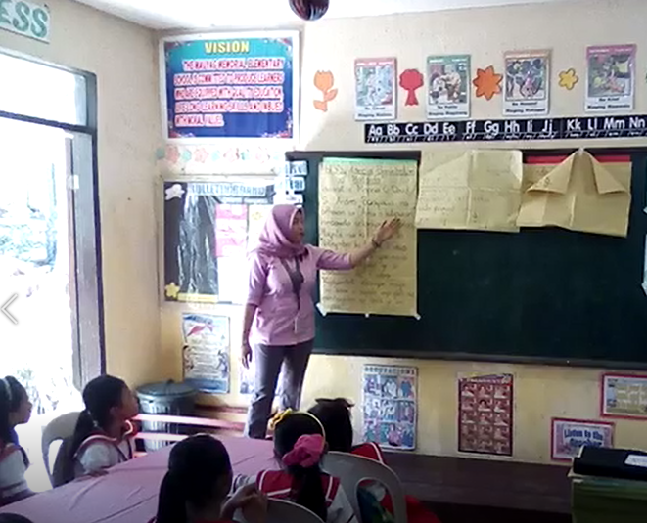
Findings: Materials Provisioning
Policy: Provide teaching & learning materials in the MoTL
In Practice (MT Lessons):
Notes:
The policy recognizes the importance of teaching and learning materials.
Our classroom materials inventories revealed that a majority of teachers had TGs, but very few students had textbooks.
Although not pictured here, when students did have textbooks, they almost always used them during the lesson.

Slide 14
Associations between Availability of Student Textbook in the MT and Teacher MT Usage in Class
G1-G2 Teachers in Mathematics and Social Studies Classes:

Slide 15
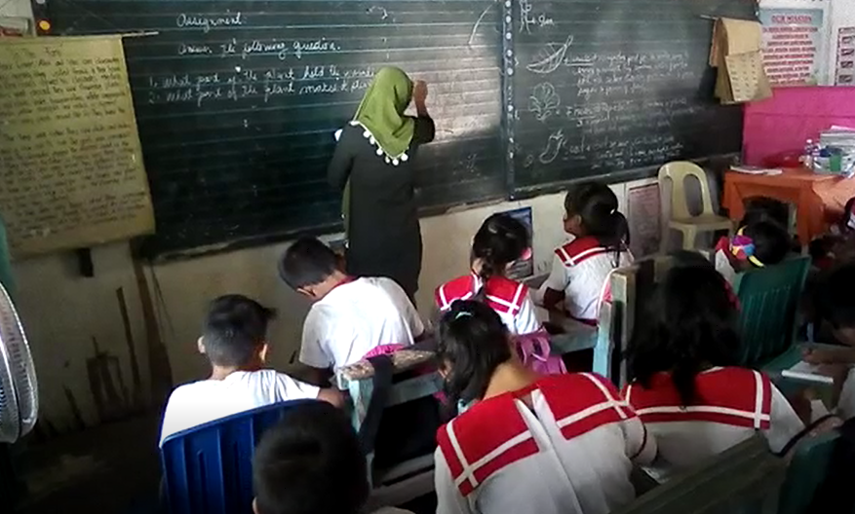
Implications
Education stakeholders could potentially increase fidelity of policy implementation by targeting these levers:
Alignment of teacher language proficiency & school assignments
Possibly, optimization of linguistic homogeneity (but controversial)
Provision of materials in the target MoTL
At the same time,
contextual factors can sometimes support, sometimes conspire against implementation, including ideological beliefs and logistical constraints.

Slide 16
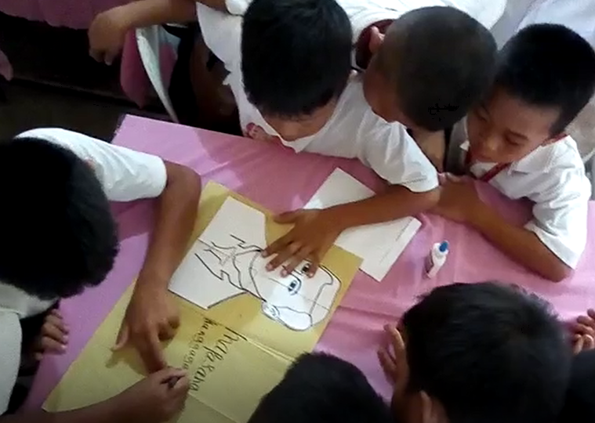
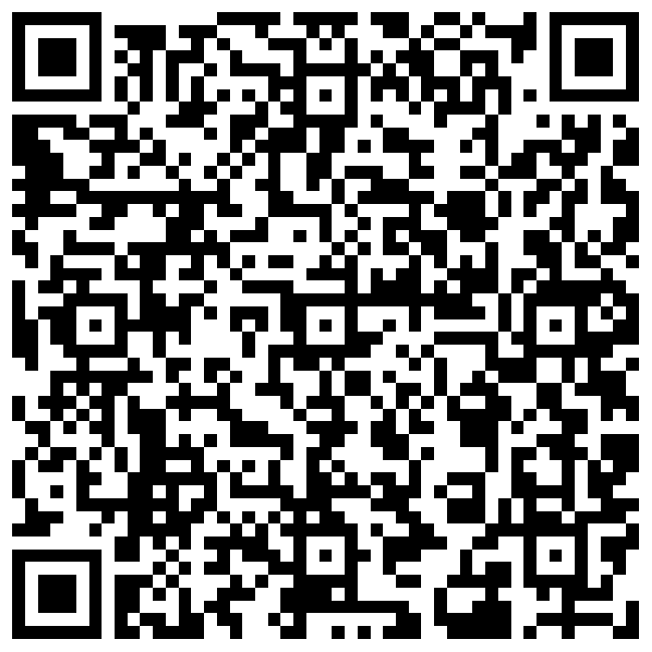
For More Information
Karon Harden
Senior Education Research Analyst
RTI International
kharden@rti.org
Co-Authors:
Patience Sowa: psowa@rti.org
Maitri Punjabi: mpunjabi@rti.org
Link to full report: https://pdf.usaid.gov/pdf_docs/PA00WKGZ.pdf
Link to accompanying regional EGRA report:
https://pdf.usaid.gov/pdf_docs/PA00WKGV.pdf
Learn more about RTI’s work at https://www.rti.org/practice-area/international-education
https://shared.rti.org/

